Slide 1
The Mission of Dayton Independent Schools is to Inspire, Engage and Grow each our Students.
Dayton Independent Schools

Slide 2
From Academics to Athletics… From Nutrition to Mental Health… om Family Support to Physical Health… Starting at Birth…well into College

Slide 3
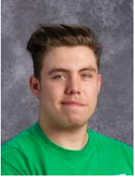
Joseph McGuire is our first junior to attend Gateway for CIT (Computer Information Technology) courses. He was one of the highest achieving students in his classes last year (including the adults in the courses) and earned the TestOut Pro certification and the A+ certification. Joseph is finishing up his minimum high school requirements for the state of KY as a dual credit student and completing more CIT courses currently in his Senior year. He is also doing this while working as IT support for our district. Joseph just completed his certification for SecurityPro. With this certification, there is a salary range of $56,000 - $78,000!

Slide 4
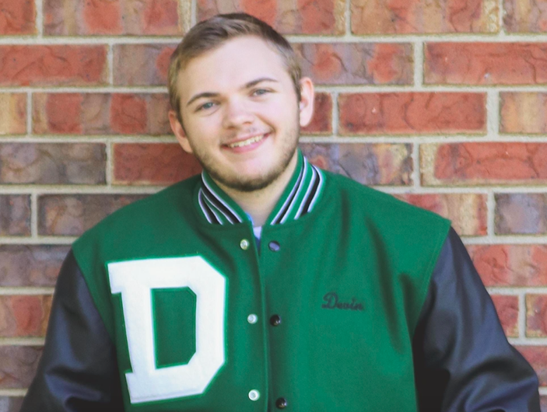
Devin Schloemer came to Dayton for his Junior year of high school and stated that he wanted to pursue a career in HVAC after high school. Due to us not being able to offer that at the ATC or at Dayton High School, he has been attending Gateway to complete his HVAC courses to hopefully finish the certification program by the time he graduates. He is finishing up his minimum high school requirements for the state of Kentucky online and goes to Gateway in the evenings to complete the HVAC courses. He is currently working in the HVAC field and will hopefully continue that after high school. Due to Devin's high academic achievement and his self-discipline to motivate himself and have a high work ethic, he does not attend classes on campus and is able to work and maintain high grades.

Slide 5
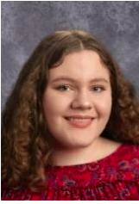
Nelleh Buschle has been taking a full college course load of classes for her Junior and Senior years at Northern Kentucky University. She has completed some virtually and some in-person on campus at NKU. She will graduate from high school with enough credits to begin her education program immediately and hopefully have a Bachelor's Degree within two years of graduating high school.

Slide 6
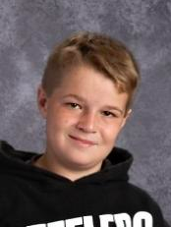
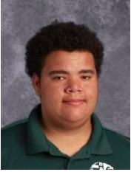
Logan Turner and Alexander Yost are two Dayton High School students that have attended the Campbell County Area Technical Center for the last two years. They are both in the electrical program at the ATC and have been working full-time during the day at local businesses in the electrical field. Alex and Logan both are completing their minimum high school requirements for the state of KY online and checking in weekly with the ATC in order to make sure they achieve their career readiness certifications by the end of their Senior year.

Slide 7
Student Achievement
2nd Highest ACT among River City Districts
Graduation rate of 96.3%. Ranks 8/19 in NKY.
State average is 90%
Top Performing Middle School among River City Districts
Top Performing District in Writing among River City Districts
Elementary and High School rank at or near the top in tested areas among River City Schools
River City Districts:
Dayton
Bellevue
Ludlow
Covington
Newport
Erlanger

Slide 8
High School Opportunities
27 Juniors and Seniors in Dual Credit
26 Juniors and Seniors in Area Technology Center
14 Juniors and Seniors in Career Technology Education (Logistics, Health Care, IT at Gateway)
3 Seniors at Skilled Trade program at Newport High School
1 Sophomore ROTC student at Scott High School
1 Junior at Gatton Academy (Youth Scholars Academy)

Slide 9
Lincoln Elementary
Five Star Preschool and Head Start
Collaboration with Reading League to develop a comprehensive reading program
Reading and Math Interventionist and Support
Grant driven Scholastic Book Fairs that provide free books for kids
One to One learning devices
Mental Health support and trauma informed care

Slide 10
Family Resource Centers
An active Resource Center in each school that meets and supports the basic needs of students and families.
Food Pantry serves and Food Packs for weekends
HealthPoint School Clinic
We have a full-time nurse, a nurse assistant, and a Nurse Practitioner who provide fundamental health care for students and families.
Mental Health Services
We have 2 full time counselors and 3 Mental Health Therapists supporting children.
School Resource Officer
We collaborate with the City of Dayton to provide an on campus police officer to protect and serve our students, staff and families
Facilities
Significant improvement to learning environment on the inside of the building
Major renovation to exterior of high school
District has purchased multiple pieces of property between two school buildings to achieve the goal of having an on campus sports complex

Slide 11
The Children we Serve… The Mission we Have.
NKY Region % of Children living in Poverty:
Covington: 28.7%
Dayton: 25.4%
Newport: 25.1%
Southgate: 20.7%
Erlanger: 15.9%
Ludlow: 15.6%
Bellevue: 12.4%
Walton Verona: 8.8%
Kenton County: 7.7%
Campbell County: 7.5%
Boone County: 7.0%
Beechwood: 3.4%
Fort Thomas: 3.1%
*Family of 4 under $26,172 in income

Slide 12
Challenges and Opportunities
Student Enrollment
Housing Market
Pandemic
Student and Family Support
Our People
Our Community
Property Development in Dayton
Our Mission
Here We Grow!

