Slide 1
Planning & Zoning Building Inspections
Planning Team
Cindy Minter, Director
Kirk Hunter
Emily Woodward
Building Inspection Team
David Rodgers
Jessica Bolton
Donnie Wright
Chuck Bixler
Kim Meeks
Phone: 859-292-3880
Email: pzadmin@campbellcountyky.gov
Visit: 1098 Monmouth Street, Suite 343
Newport KY 41071

Slide 2
Planning & Zoning Commission
Charles “Chuck” Peters, Chair
Kells Barrett, Vice Chair
Sandy Trutschel
Jerry Huntley
Roy Newman
Bob Schrage
Board of Adjustments
Don Lynn, Chair
Michael Carr
Bob Crittendon
Edith Mariani
Fran Wetterich

Slide 3
Zoning Planned Administrative Updates
✓Relax Outdoor Dining Text – July 2021
✓Add Mobile Food Vending – July 2021
✓Expand CBD east to Main Street (from Comprehensive Plan) – January 2022
✓Adjust I‐1 Zone and modernize I‐1 text – January 2022
Modify average conditions to assist with infill development – ONGOING
Modify conditions to encourage adaptive reuse of large historic structures – ONGOING
Evaluate zones along 6th Ave from Erwin Terrace to O’Fallon
Update Sign Ordinance
Update Flood Zone Protection Ordinance
Remove Phased CBD along Fifth Ave
Address Short‐Term Rentals
Subdivision Regulations

Slide 4
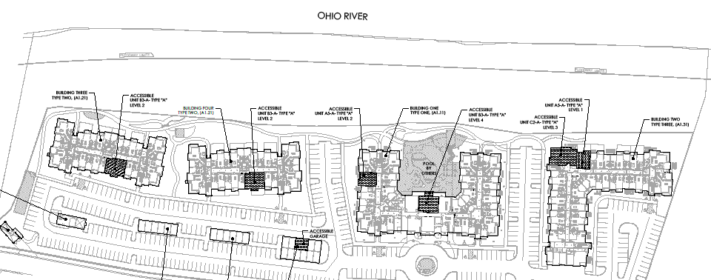
Building Permits (new Construction and Renovations)
Permit Year | Estimated Construction Value
2018 | $38,042,336
2019 | $ 3,055,870
2020 | $10,515,075
2021 | $ 2,168,107
2022 | TBD

Slide 5
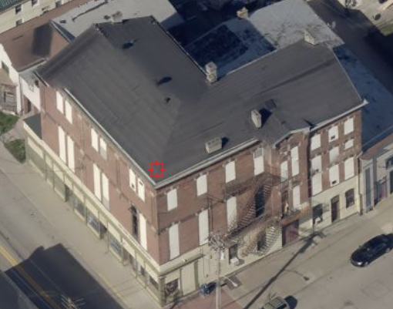
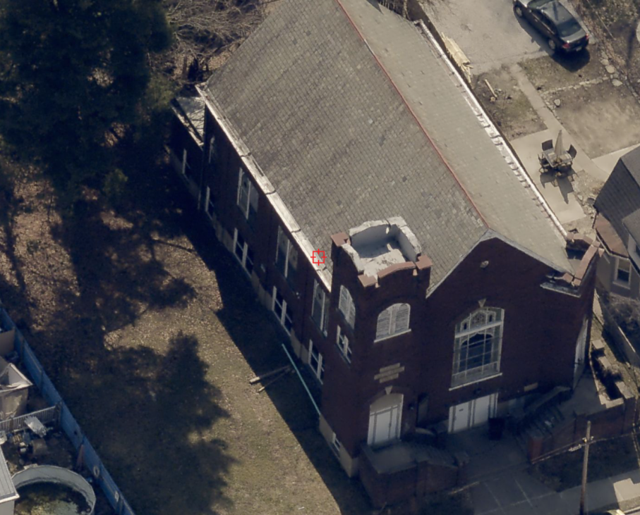
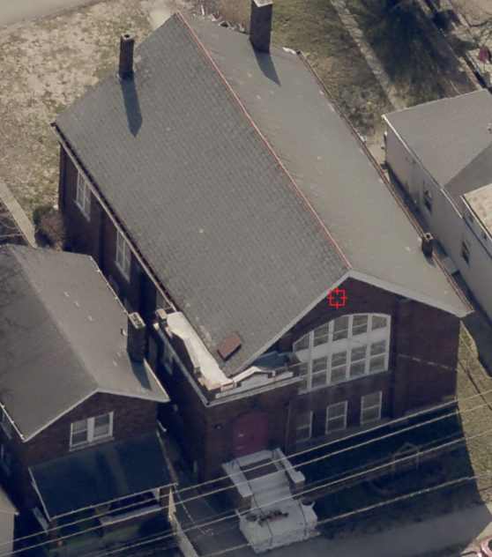
Goals for 2022
Planning & Zoning Building Inspections
Community Driven Planning and Zoning Updates
Quality Investments in Dayton for Housing and Commercial Properties

Slide 6
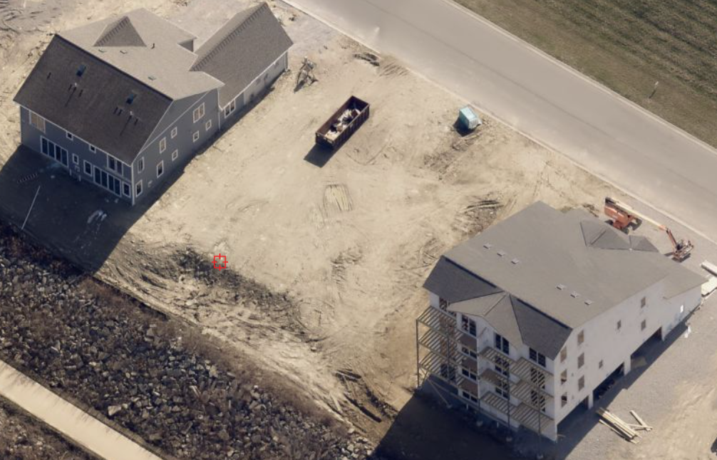
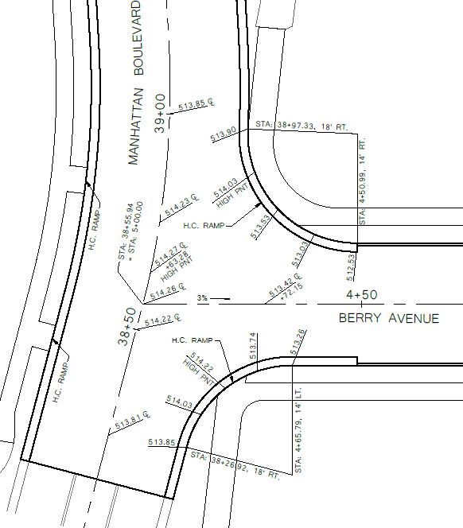
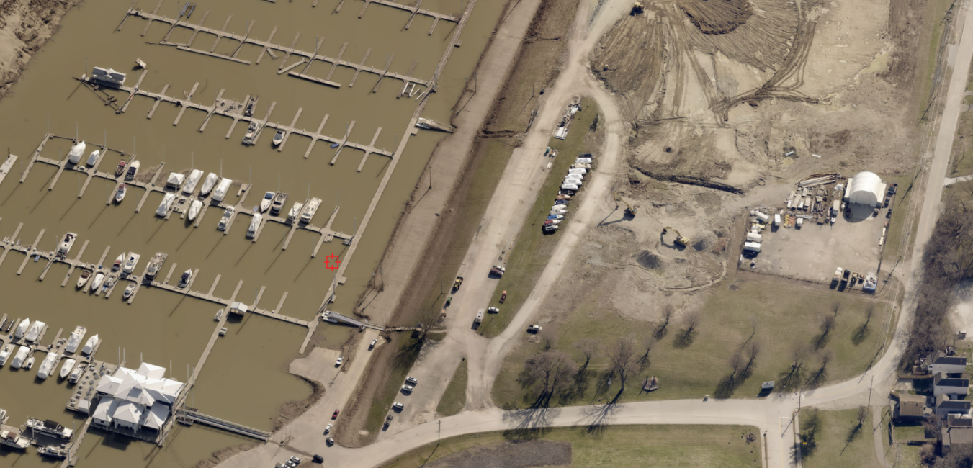
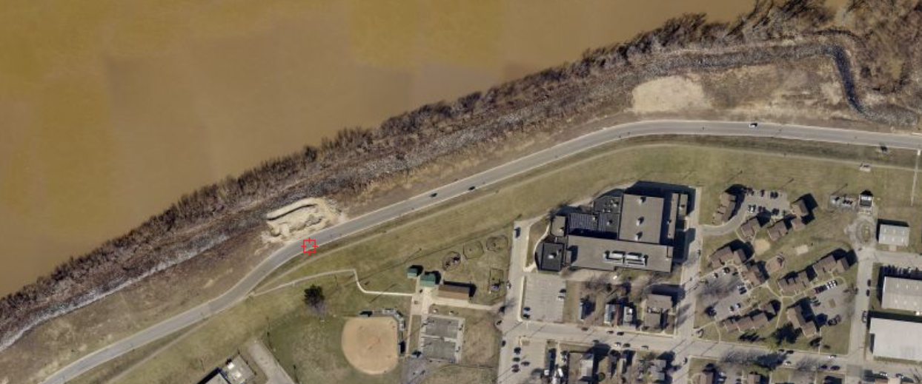
Continued Investments in Manhattan Harbour

Slide 7
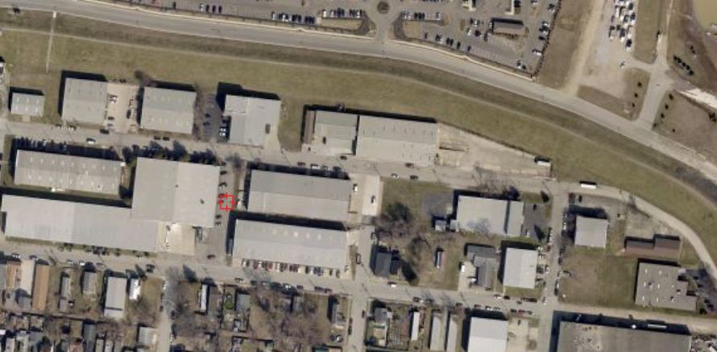
Reinvestment in Industrial Park

