Slide 1
Dayton Police Department
2021Accomplishments
And
2022 Goals

Slide 2
2021 Accomplishments
Community Events and Just Being Us
Bridge Program
Less Lethal
Updating equipment
Retention Pay and Pay Scale
2021-2017 Crime statistics numbers
Parking Enforcment
K-9

Slide 3
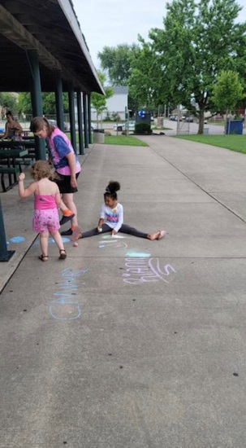
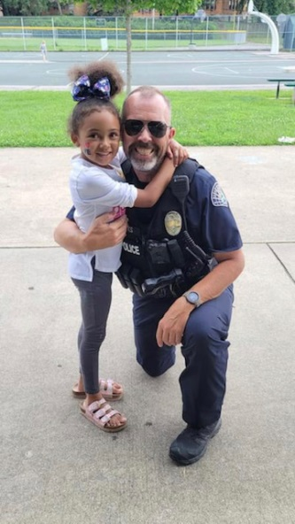
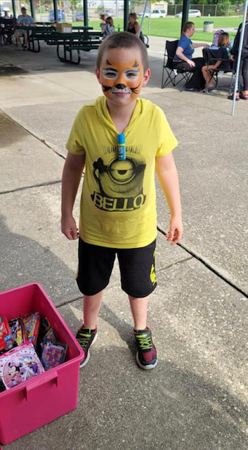
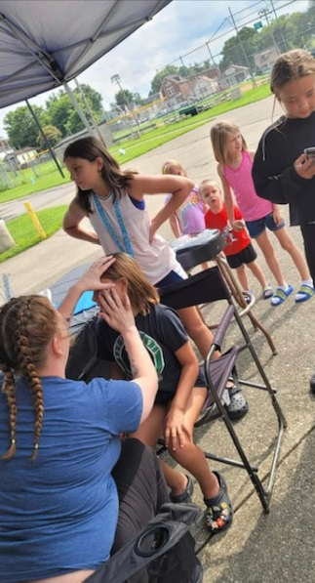
Dayton Summer Bash

Slide 4
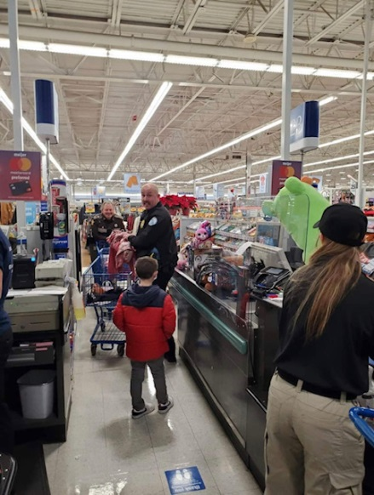
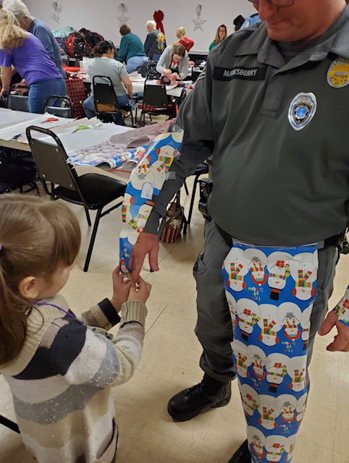
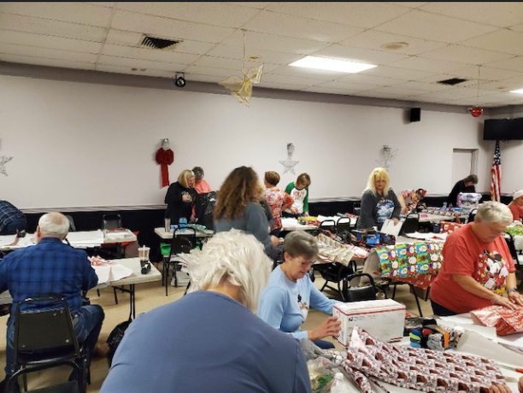
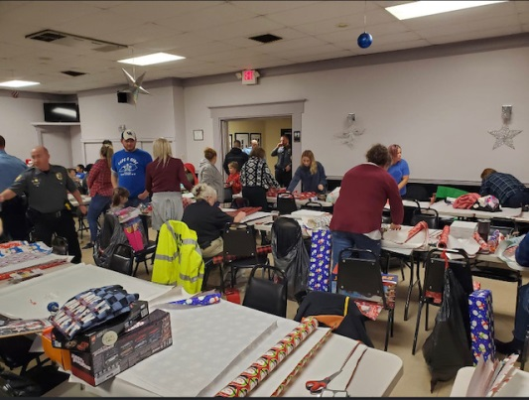
Cops N Kids

Slide 5
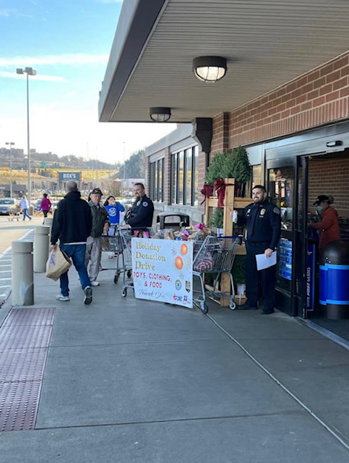
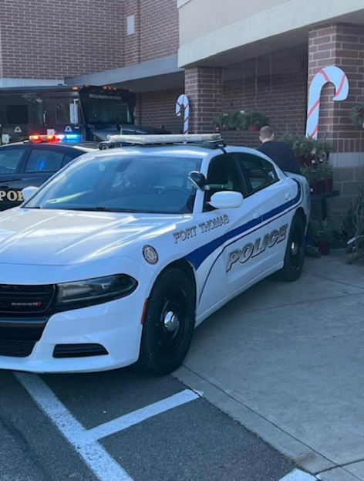
Holiday Donation Drive

Slide 6
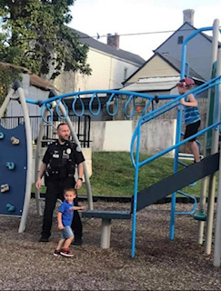
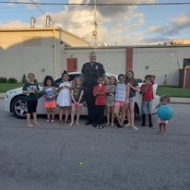
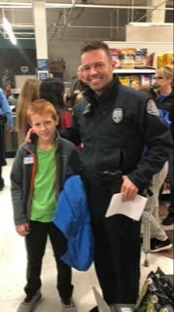
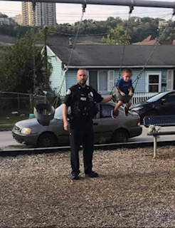
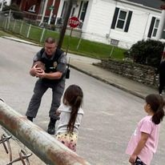
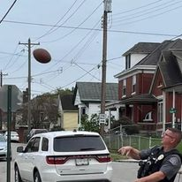
US

Slide 7
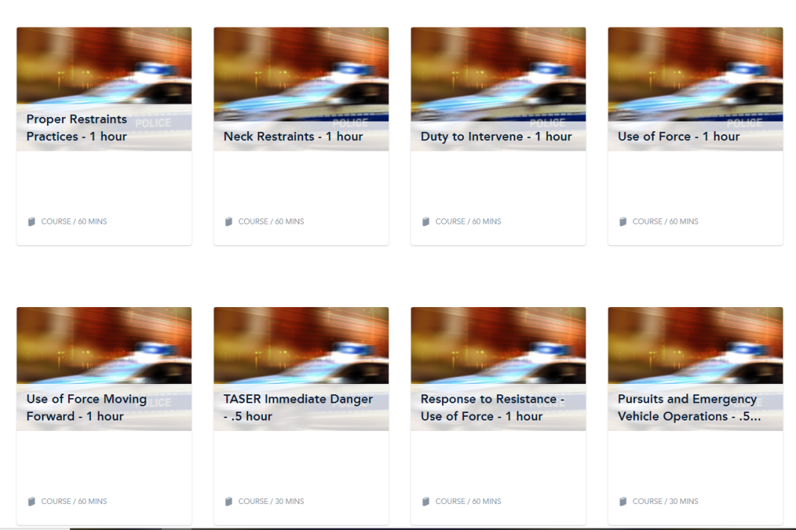
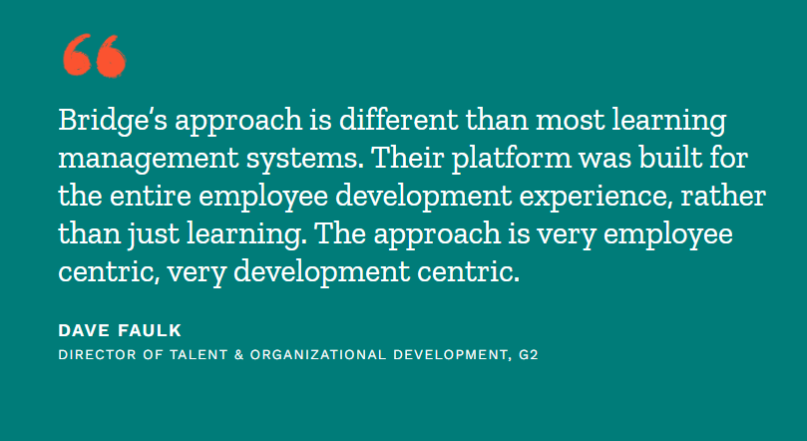
Bridge Learning

Slide 8
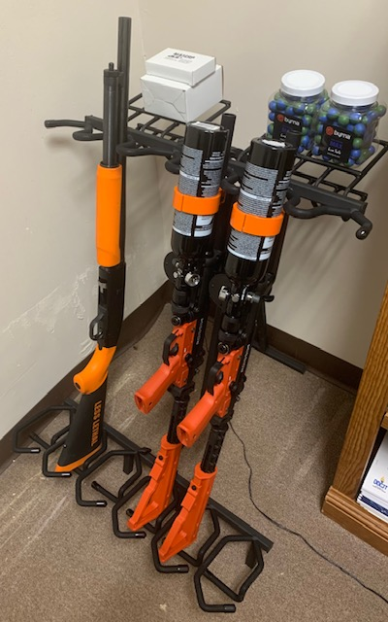
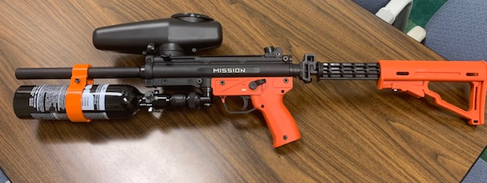
Less Lethal

Slide 9
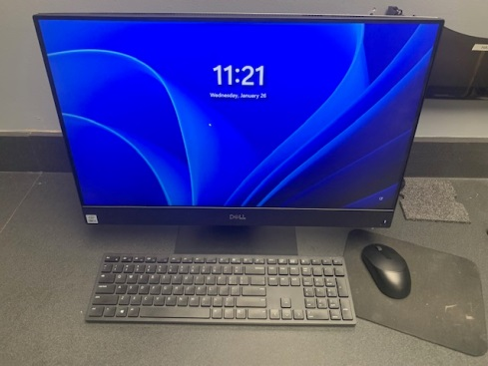
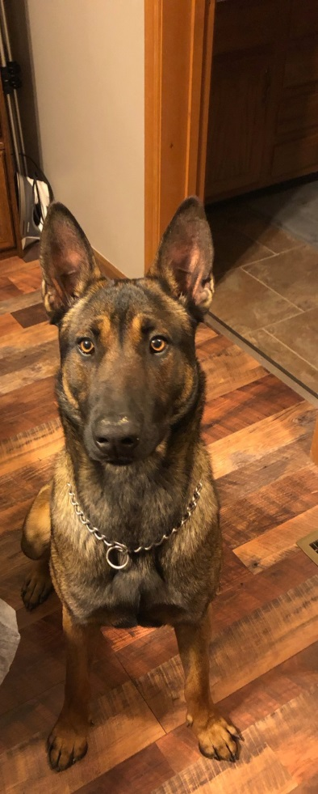
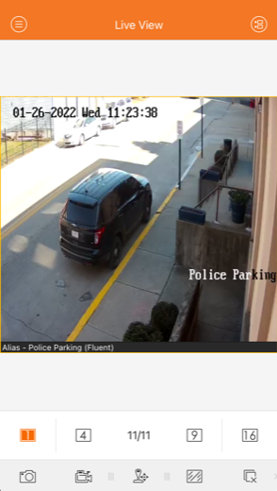
Updating Equipment

Slide 10
Retention Pay and Pay Scale

Slide 11
2021 Crime Statistics

Slide 12
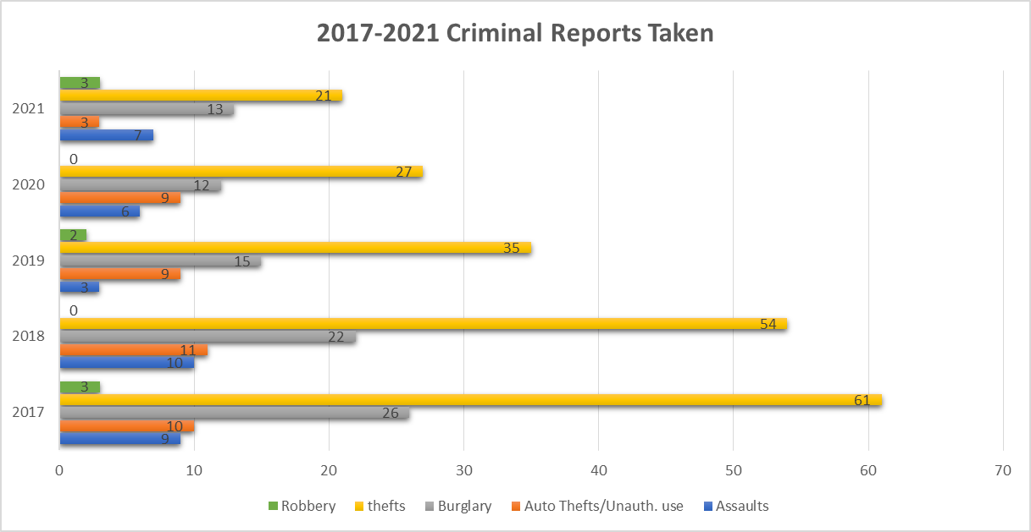

Slide 13
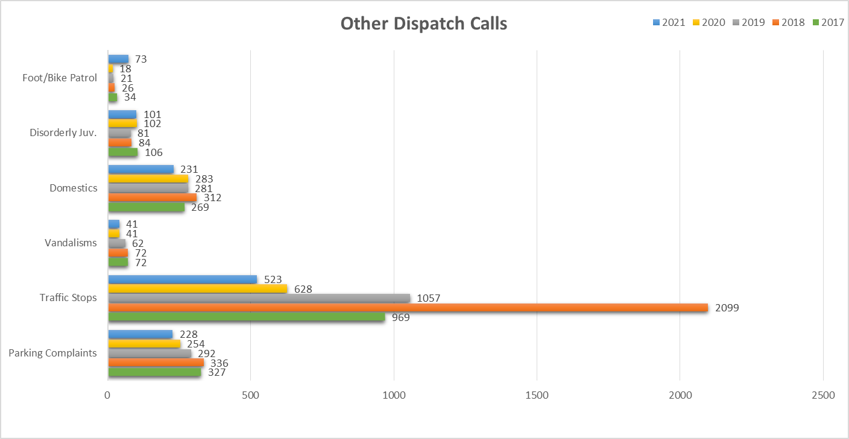

Slide 14
Parking Enforcement

Slide 15
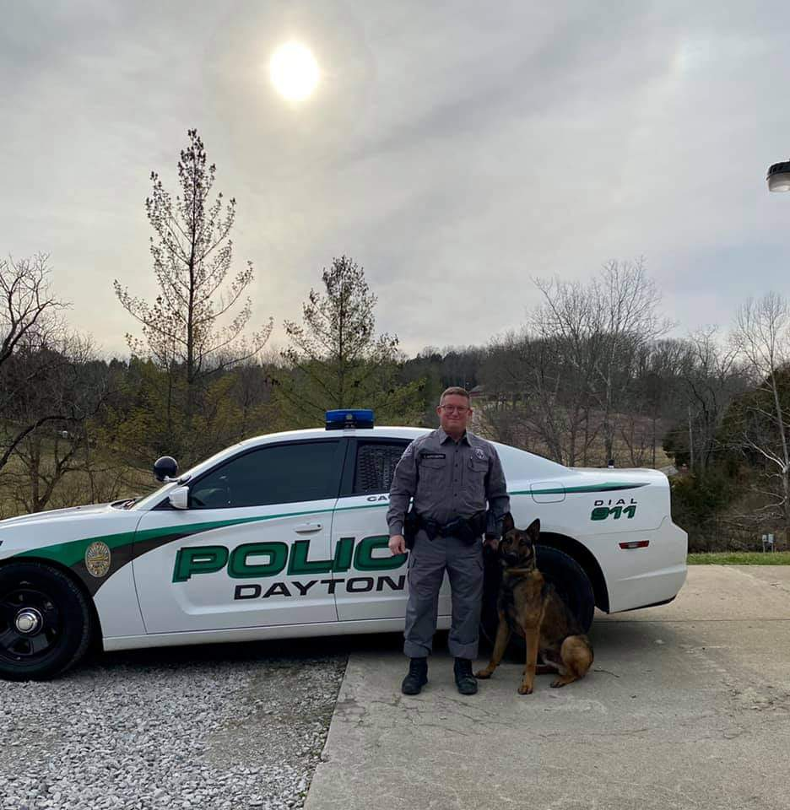
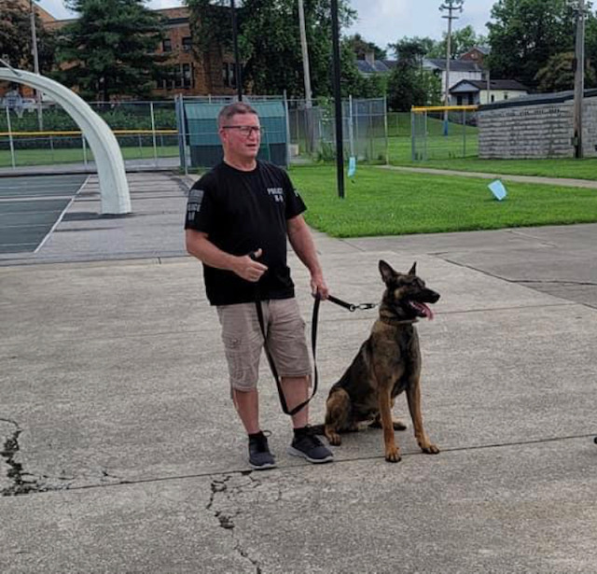
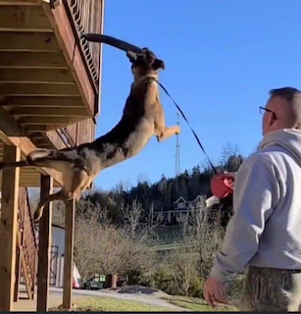
K-9 KAI

Slide 16
2022 Goals
Update computers in Cruisers & Office.
Add another officer with growing population.
Continue with Retention Pay.
Two (2) cruisers.
Combat drug activity with more seizures.
Continue Police Community Events
Dayton Summer Safety – May 25th ,2022
Dayton Summer Bash – June 25th ,2022
Holiday Food Drive – December 3rd, 2022

