Slide 1
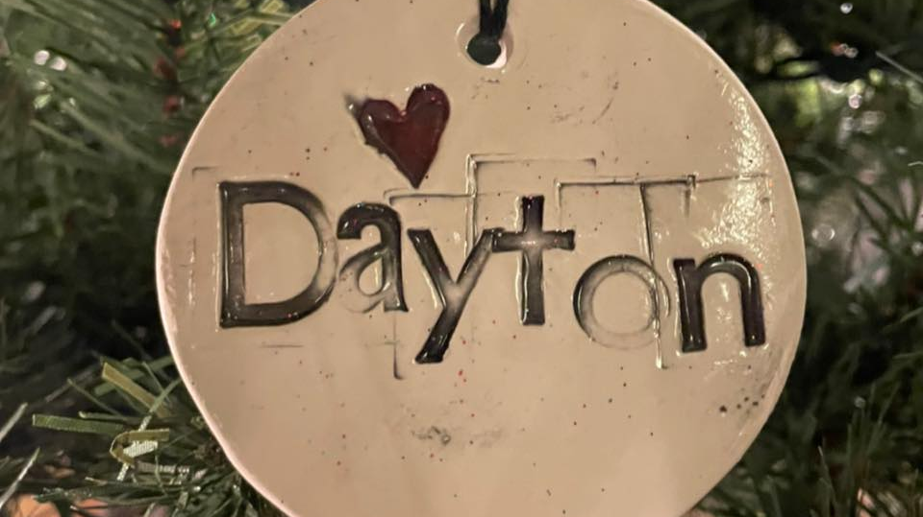
Dayton Board of Architectural Review

Slide 2
Who Are We??
Mission
It is the mission of the Board to create and maintain a vibrant community that preserves Dayton's historical heritage and architecture.
Vision
It is the vision of the Board that historic preservation of places, structures, works of art or similar objects having special historical, cultural, or aesthetic interest to the citizens of Dayton will enhance a sense of community, help to retain businesses and homeowners, and attract new residents.
Primary Focus
The primary focus of the Board shall be on the designated Dayton’s Local Historic District, as recognized by the City of Dayton, Kentucky's Code Ordinance.
Secondary Focus
The secondary focus of the Board shall be the education and promotion of Historic Preservation in the City of Dayton as its entirety. However, this focus is not to take precedent over the aforementioned areas of focus.

Slide 3
What Do We Do?
COA Review & Approval
Historic Preservation Awards
Halloween & Christmas Decorating Competitions
Historic Preservation Help

Slide 4
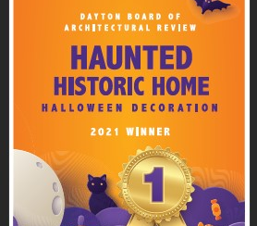
Calendar
Historic Preservation Awards (September 2022)
Halloween Decoration Contest (October 2022)
Christmas Decoration Contest (December 2022)
Northern Kentucky Restoration Weekend (May 20 & 21, 2022)

Slide 5
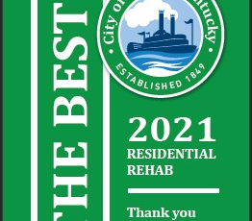
Goals for 2022
Review of the Historic District Guidelines
Historic Architecture Information on Social Media
Build Committee Membership

Slide 6
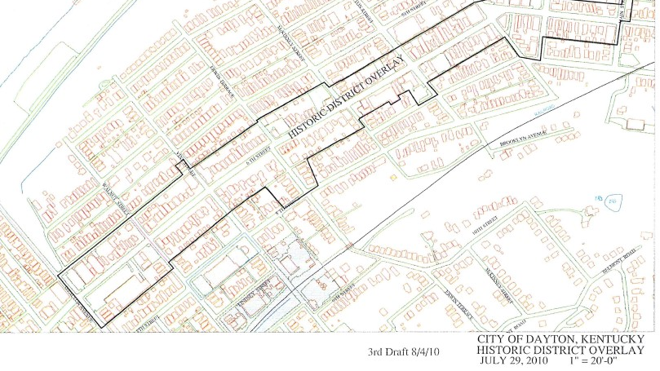
Find Us On Facebook & Instagram
Facebook – Dayton Board of Architectural Review
Instagram - @daytonky_bar
Email – daytonkyBAR@gmail.com

